Slide 1
BLOOD CANCER DETECTION USING MACHINE LEARNING AND IMAGE PROCESSING
PROJECT ASSOCIATES
M.MAHESH BABU – 21711A0434
SK.YASIN - 21711A0453
T.VENKAT ADITHYA- 21711A0460
U.VENKAT AJAY - 21711A0462
PROJECT GUIDE
JK NEELIMA BAI M.Tech ASSISTANT PROFESSOR

Slide 2
ABSTRACT
This project focuses on detecting blood cancer using image processing and machine learning techniques. By analyzing blood smear images, we aim to identify abnormal cells indicative of various types of blood cancers, such as leukemia.
The project utilizes existing medical datasets for training a machine learning model, which can enhance diagnostic accuracy. This approach combines principles of electronics and communication engineering, providing a valuable tool for early detection and improving patient outcomes in healthcare settings.

Slide 3
INTRODUCTION
Blood cancer poses a significant health challenge, making early detection crucial for effective treatment.
This project explores the use of image processing and machine learning techniques to identify abnormal blood cells in smear images.
By leveraging existing medical datasets, we aim to develop a reliable system that can assist healthcare professionals in diagnosing blood cancers.
Ultimately, this approach has the potential to improve patient outcomes through timely and accurate diagnosis.

Slide 4







Tools & Libraries used
Google Colab
Kaggle
Python
Pandas
Matplotlib
Sci-kit learn
Tensorflow
OpenCV
Github

Slide 5
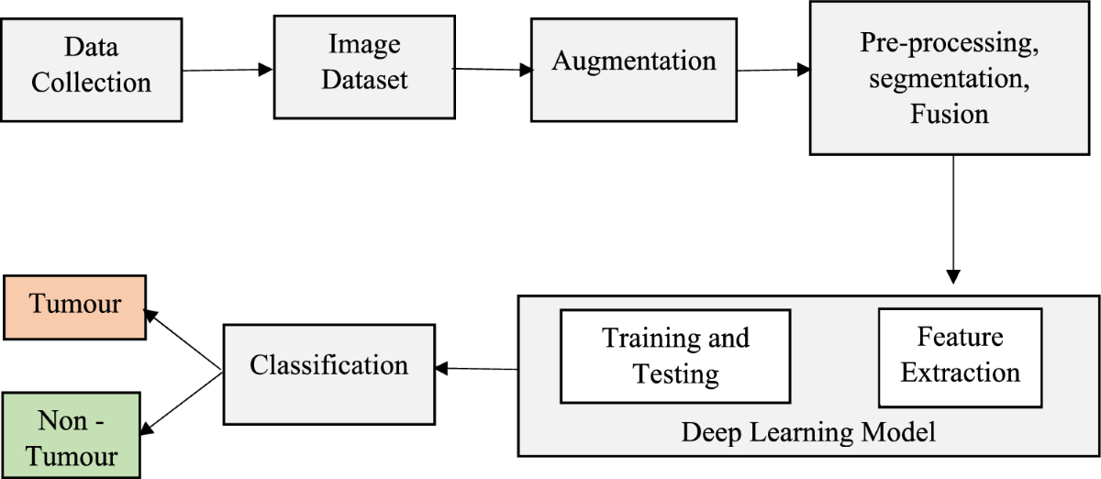
FLOW CHART

Slide 6
PROCEDURE
Data Collection is Primary step in this project collect the dataset from Kaggle related to blood cancer
Collect the images from the dataset such as blood smear microscopic images and label it
Label images with information such as cancer type, stage, or healthy vs. abnormal cells
Next step from this project then we need to pre process the images from the dataset
Apply the different type of techniques to extract the different patterns for the images

Slide 7
By applying Augmentation techniques like geometric transformation , Color transformations
Use the contrast enhancement , adaptive histogram equalization and Image normalization
These techniques helps the images to adjust brightness, cropping, zooming and saturation
Feel the augmented images to train the machine learning model by image processing techniques earlier mentioned
From this augmentation extract the feature extraction techniques like shape features ,Color features

Slide 8
For Data Manipulation we use Numpy and Pandas which used for handling the numerical operation and data extraction
We use OpenCV the image processing library to provide a wide range of image processing for displaying images
Pillow for manipulating and saving images in different format like .jpg , .jpeg , .png etc
Scikit-Learn for importing the algorithms like Support vector Machine, Random forest and K-nearest Neighbours for hyperparametric tuning
We use Tensorflow for including CNN for image classification tasks

Slide 9
!unzip bloodcancer.zip
import pandas as pd import numpy as np import matplotlib.pyplot as plt import seaborn as sns from sklearn.model_selection import train_test_split from sklearn.preprocessing import StandardScaler from sklearn.linear_model import LogisticRegression from sklearn.metrics import accuracy_score, confusion_matrix from sklearn.ensemble import RandomForestClassifier from sklearn.neighbors import KNeighborsClassifier from sklearn.svm import SVC from sklearn.naive_bayes import GaussianNB from sklearn.tree import DecisionTreeClassifier from sklearn.metrics import classification_report from sklearn.model_selection import cross_val_score from sklearn.model_selection import GridSearchCV from sklearn.metrics import roc_auc_score, roc_curve import warnings warnings.filterwarnings('ignore')

Slide 10
import os import numpy as np from sklearn.model_selection import train_test_split from tensorflow.keras.preprocessing.image import ImageDataGenerator from tensorflow.keras.applications import ResNet50 from tensorflow.keras.applications import EfficientNetB0 from tensorflow.keras.applications import VGG16 from tensorflow.keras.layers import Dense, Flatten, Dropout from tensorflow.keras.applications.efficientnet import preprocess_input from tensorflow.keras.models import Model from tensorflow.keras.optimizers import Adam from sklearn.preprocessing import LabelEncoder import matplotlib.pyplot as plt from tensorflow.keras.callbacks import EarlyStopping from tensorflow.keras.preprocessing.image import load_img, img_to_array from tensorflow.keras.applications.resnet50 import preprocess_input from tensorflow.keras.regularizers import l2

Slide 11
dataset_dir = '/content/Original’
class_names = ['Benign', 'Pre', 'Pro', 'Early’]
images = []
labels = []
for class_name in class_names:
class_dir = os.path.join(dataset_dir, class_name)
for img_name in os.listdir(class_dir):
img_path = os.path.join(class_dir, img_name)
img = load_img(img_path, target_size=(224, 224)) img = img_to_array(img)
img = preprocess_input(img) images.append(img) labels.append(class_name)
dataset_dir = '/content/Segmented’
class_names = ['Benign', 'Pre', 'Pro', 'Early']

Slide 12
import tensorflow as tf
from tensorflow.keras.models import Sequential
from tensorflow.keras.layers import Conv2D, MaxPooling2D, Flatten, Dense from tensorflow.keras.utils import to_categorical
from tensorflow.keras.preprocessing.image import ImageDataGenerator
from sklearn.model_selection import train_test_split

Slide 13
import numpy as np model = Sequential() model.add(Conv2D(32, (3, 3), activation='relu', input_shape=(224, 224, 3))) model.add(MaxPooling2D((2, 2))) model.add(Conv2D(64, (3, 3), activation='relu')) model.add(MaxPooling2D((2, 2))) model.add(Conv2D(128, (3, 3), activation='relu')) model.add(MaxPooling2D((2, 2))) model.add(Flatten()) model.add(Dense(128, activation='relu')) model.add(Dense(4, activation='softmax')) model.compile(optimizer='adam', loss='categorical_crossentropy', metrics=['accuracy']) history= model.fit(X_train, y_train, epochs=10, batch_size=32, validation_data=(X_test, y_test)) loss, accuracy = model.evaluate(X_test, y_test) print(f"Test Loss: {loss:.4f}") print(f"Test Accuracy: {accuracy:.4f}")

Slide 14
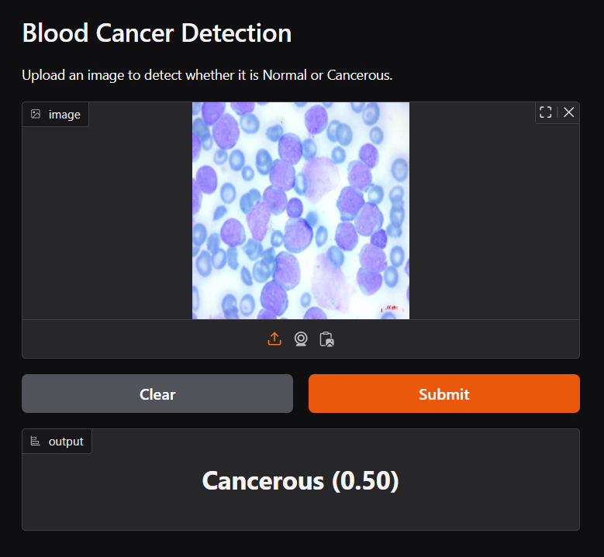
Output

Slide 15
Advantages
Early Detection
Reduce Human Error
Faster Diagnosis
Cost Reduction
Real Time Analysis

Slide 16
Thank You
….

